Slide 1
DATA MANAGEMENT & BUSINESS INTELLIGENCE

Slide 2
01
02
04
06
05
07
BUSINESS PROCESS
OLTP
OLaP
Bi dashboard
03
etl
conclusion
Data
generation

Slide 3
Business process
4
Start production
1
Customer order
2
Raise work order
customer
SALES DEPT
SUPPLY CHAIN dept
PRODUCTION dept
3
Purchase parts
5
Issue invoice
BUSINESs PROCESS
oltp
Data generation
olap
etl
BI DASHBOARD
CONCLUSION

Slide 4
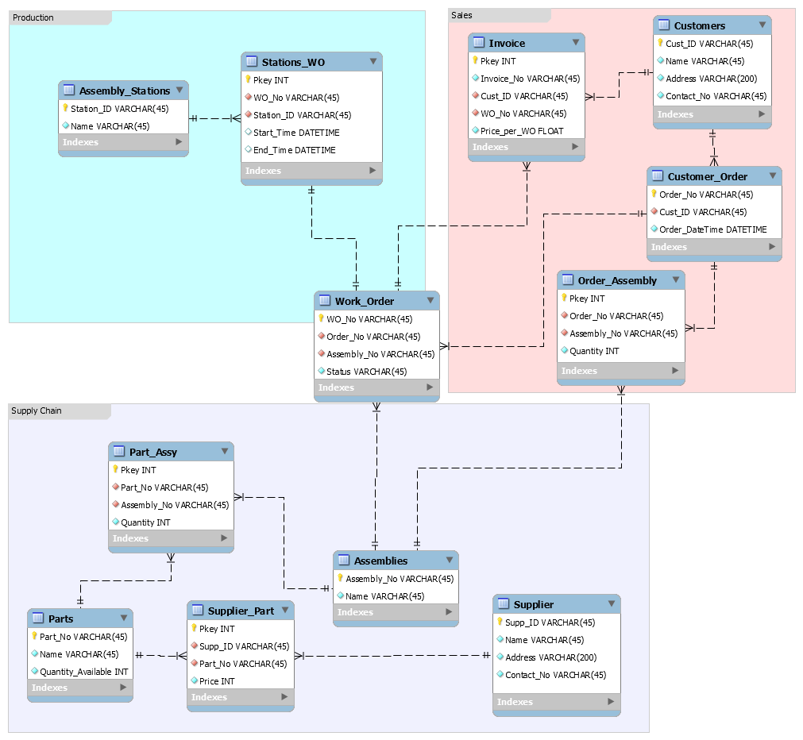
oltp
Sales Department
Maintain customer information
Process customers’ orders
Bills after completion
Supply Chain Department
Maintain supplier information
Order assemblies’ part from suppliers
Monitor quantity of parts
Production Department
Receive work orders
Assemble parts
Keep track of production time
BUSINESs PROCESS
oltp
Data generation
olap
etl
BI DASHBOARD
CONCLUSION

Slide 5

DATA GENERATION
Customer and Supplier information
Name, address & contact number
Using Python Faker and Faker-e164 packages
Price of suppliers’ parts
Same part is sold at a different price by different supplier
Sampled from Gaussian distribution using NumPy random normal
Selling price of products
Increases over the years
E.g. price of laptop increases from $3200 to $3500 from 2015 to 2019
Simple if-else statements
Timestamp
Customers’ orders generated randomly between 2015 to 2019
20% are returning customers
Production assumed to start immediately when orders are received
Production duration for each part randomly sampled using Python inbuilt random choices
BUSINESs PROCESS
oltp
Data generation
olap
etl
BI DASHBOARD
CONCLUSION

Slide 6
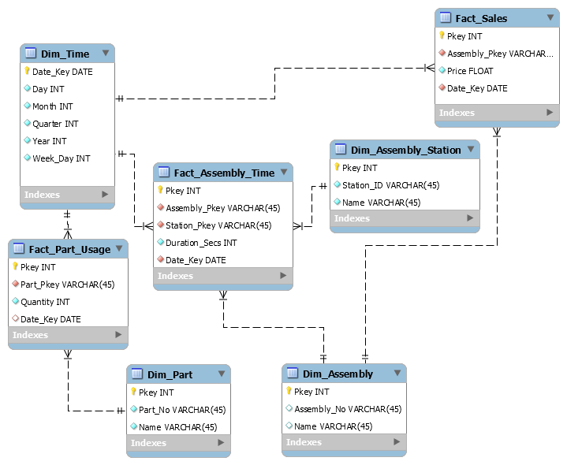
OLAP
BUSINESs PROCESS
oltp
Data generation
olap
etl
BI DASHBOARD
CONCLUSION

Slide 7
ETL
OLTP
Assembly_Stations
Parts
Work_Order
Assemblies
Part_Assy, Stations_WO, Work_Order
Stations_WO, Work_Order
Invoice, Work_Order, Order_Assembly, Stations_WO
OLAP
Dim_Assembly_Station
Dim_Part
Dim_Work_Order
Dim_Assembly
Fact_Part_Usage
Fact_Assembly_Time
Fact_Sales
BUSINESs PROCESS
oltp
Data generation
olap
etl
BI DASHBOARD
CONCLUSION

Slide 8
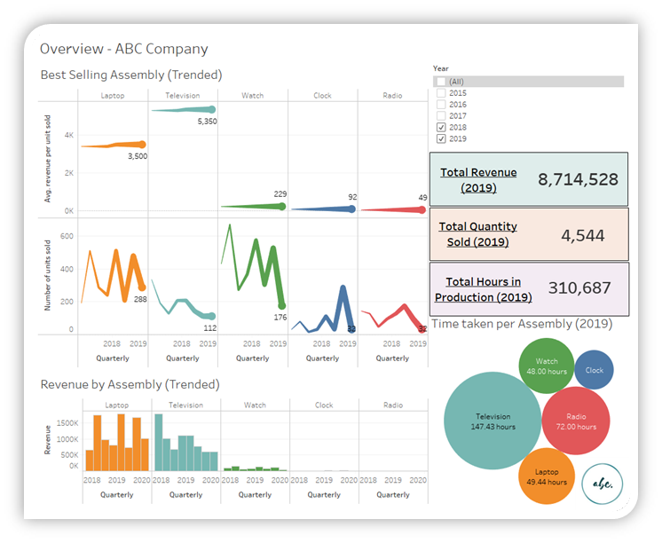
BI DASHBOARD - OVERVIEW
ID | Requirements | Priority
1 | To provide an OLAP solution to facilitate analytics for sales, production and supply chain departments. | High
2 | Revenue statistics to be tracked at an assembly-level | High
3 | Revenue breakdown into number of units sold and average revenue of product to be tracked | High
Shows an overview of key statistics for that year
Trended revenue statistics tracked at assembly-level
Trended revenue statistics broken down into revenue per unit sold and number of units sold
Takeaway
May be beneficial to streamline efforts to improve core propositions of our laptop and television products, instead of spreading ourselves thin with other products.
BUSINESs PROCESS
oltp
Data generation
olap
etl
BI DASHBOARD
CONCLUSION

Slide 9
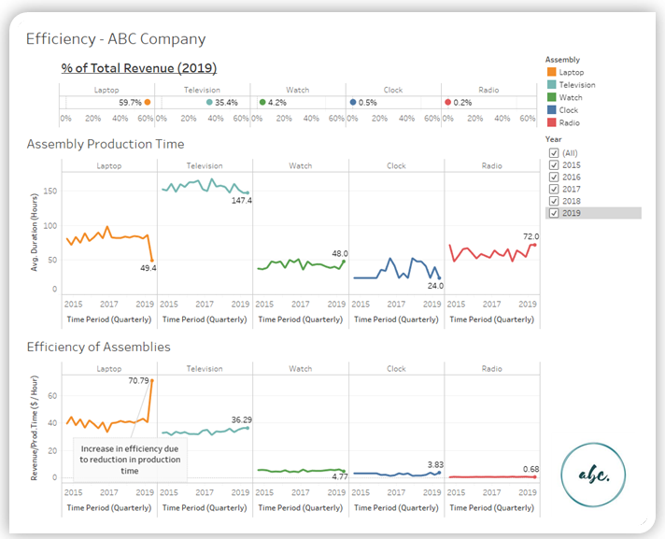
BI DASHBOARD - EFFICIENCY
ID | Requirements | Priority
1 | To provide an OLAP solution to facilitate analytics for sales, production and supply chain departments. | High
4 | Assembly time (trended) is tracked for improvement potential (Which assembly takes the shortest time to produce?) | High
5 | Revenue per assembly time ($/hour) to be tracked to normalize revenue figures – Trended | High
6 | Revenue breakdown by assembly | Medium
Shows a trended overview of key efficiency statistics by assembly product
Assembly Production Time
Revenue/Production Time ($/Hour)
Takeaway
The benefits of leasing more efficient machinery for laptop assembly this quarter has come through, with a improvement of in average time taken to assembly by 43%.
This improved revenue/production time figures to around 70.79 $/hour for laptops.
BUSINESs PROCESS
oltp
Data generation
olap
etl
BI DASHBOARD
CONCLUSION

Slide 10
CONSIDERATIONs WHEN SCALING UP
Handling Voluminous Inactive Data
Reasons: Regulatory (E.g. Data Retention Law), Storage Cost, Index Maintenance
Truncate
Archive through Partitioning:
Fact: Partition on Date Key (part of Primary Keys)
Dimension (e.g. Customer): Partition on Archive Indicator Column
Data Lineage for Extensive ETLs and Tables
Reasons:
Trace warehouse record back to origination (i.e. source, ETL details)
Especially if there are too many ETLs and table
How?
Provide [Lineage Key] attribute to the dimension, which links to [Lineage Table] records
Customer
PK | CustID Key
 | …
 | [Lineage Key]
Customer
PK | [Lineage Key] | Int
 | Date Time Loaded | Datetime
 | SourceTable | Nvarchar(50)
BUSINESs PROCESS
oltp
Data generation
olap
etl
BI DASHBOARD
CONCLUSION

Slide 11
THANK YOU

